Slide 1
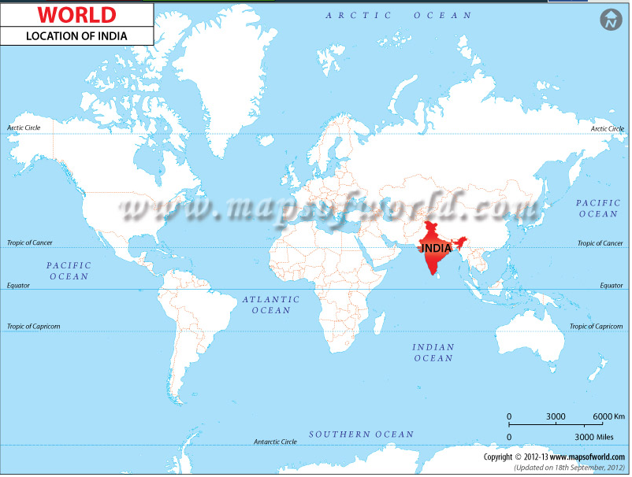

Slide 2
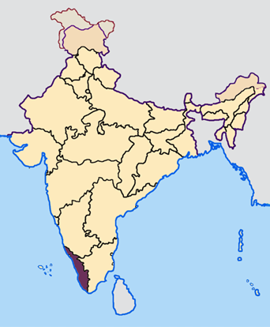
Kerala in India

Slide 3
Harvest festival
It is in August / September
Lasts for ten days
Entire family (grandparents, uncles and aunts) meet every day for elaborate meals
They sing folk songs, dance and play games together
They make a design with flowers in front of their house
Not sure if we will have time for the Mahabali story so I didn’t include it

Slide 4
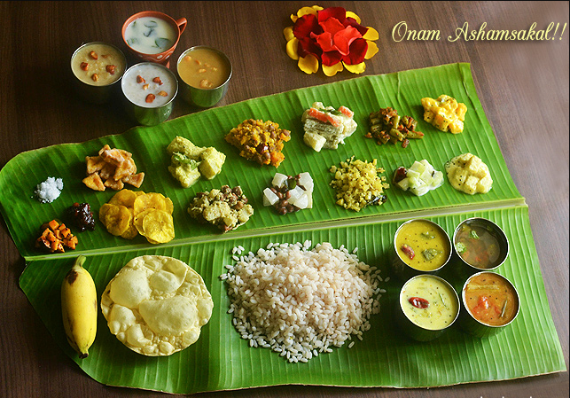
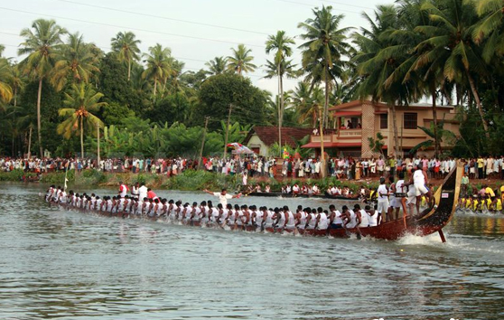

Slide 5
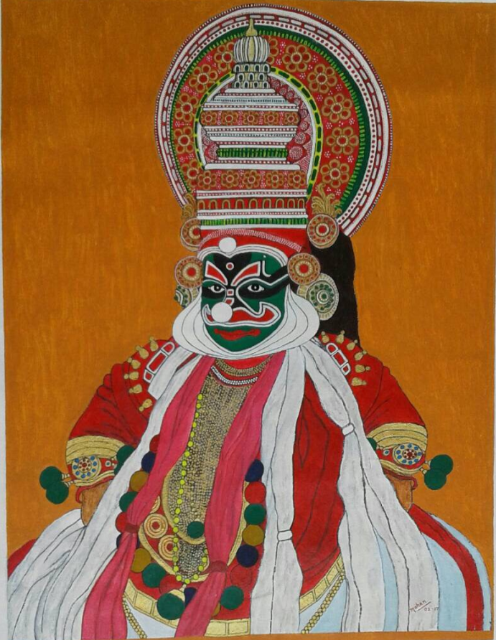
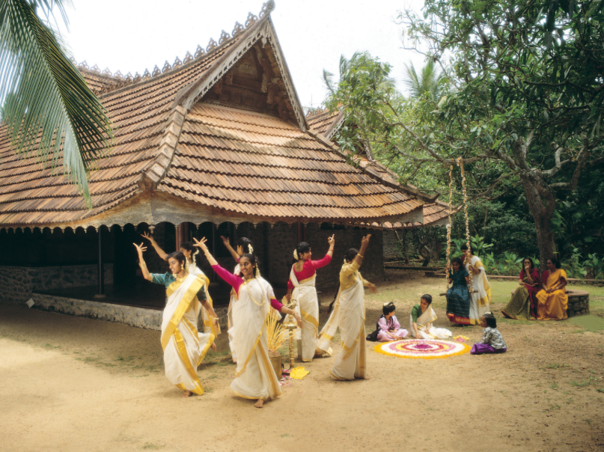

Slide 6
